Slide 1
Getting Started on Building Tables
Using SSMS and SQLCMD

Slide 2
Data Dictionary: Elements you need to know to get started
Table: Field
Column Name | Description | Data Type | Size | Identity | Unique | Default | Check | Allow Nulls | Index
FieldName | PK; Unique field name | varchar | 20 |  |  |  |  |  | Y
Street | Field street | varchar | 30
City | Field city | varchar | 25
State | Field state | char | 2 |  |  | ‘FL’ | LIKE ‘[A-Z][A-Z]’
Zip | Field zip | char | 5 |  |  |  | LIKE '[0-9][0-9] [0-9][0-9][0-9]'
Table: Match
Column Name | Description | Data Type | Size | Identity | Unique | Default | Check | Allow Nulls | Index
MatchID | PK; Unique sequential match ID number | smallint |  | Y |  |  |  |  | Y
Date | Date match scheduled | date |  |  |  |  | >= GETDATE()
FieldName | FK to Field table; location of match | varchar | 20
Table: Match Outcome
Column Name | Description | Data Type | Size | Identity | Unique | Default | Check | Allow Nulls | Index
MatchID | CPK; FK to Match table | smallint |  |  |  |  |  |  | Y
TeamName | CPK; FK to Team table | varchar | 20 |  |  |  |  |  | Y
Score | Goals scored in match by team | tinyint |  |  |  |  | >= 0 | Y

Slide 3
Properties: Definitions and Terms to get you started
Identity (auto generated)
Seed and increment
Default value
Auto filled by SQL Server
Naming (indexes and Constraints)
PK_Index, AK_Index
UN_Index
IX_Index
CK_constraint
CN_constraint
PK-FK Relationship
FK_ForeigntablePrimarytable

Slide 4
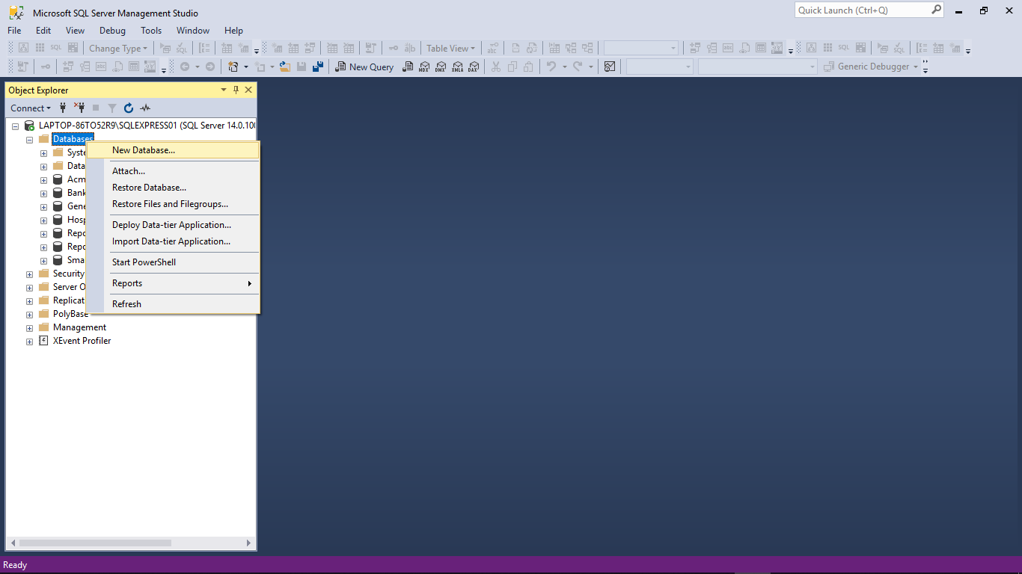
Building Tables with SSMS: New Database

Slide 5
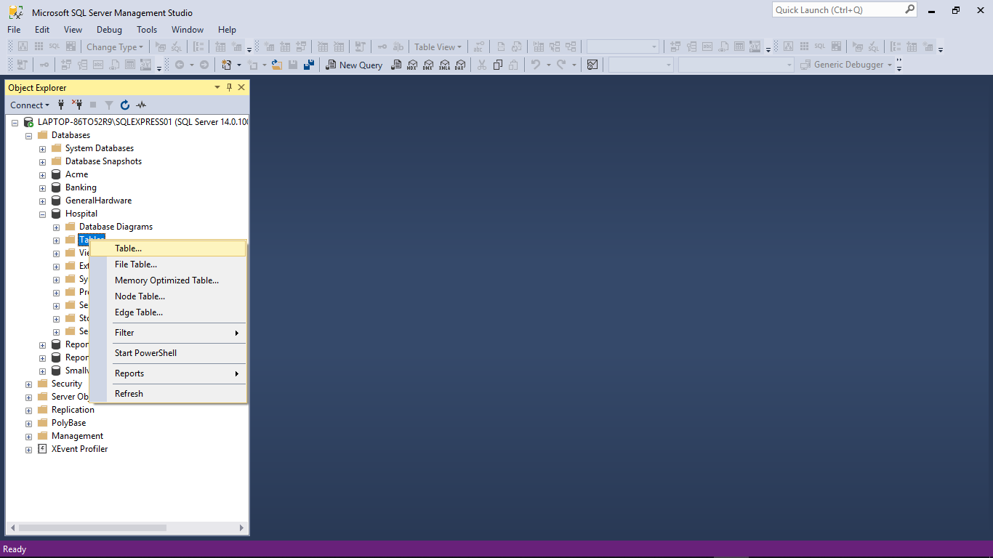
Building Tables with SSMS: New Table

Slide 6
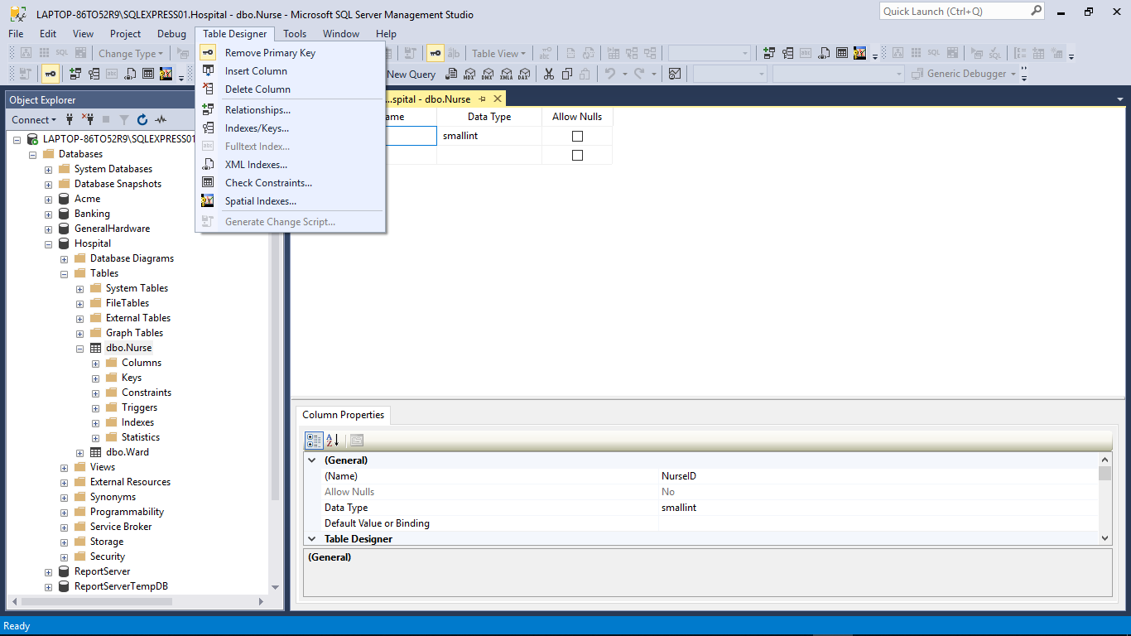
Building Tables with SSMS: Table Designer, Properties

Slide 7
Data Dictionary: Why you need these items
Table: Field
Column Name | Description | Data Type | Size | Identity | Unique | Default | Check | Allow Nulls | Index
FieldName | PK; Unique field name | varchar | 20 |  |  |  |  |  | Y
Street | Field street | varchar | 30
City | Field city | varchar | 25
State | Field state | char | 2 |  |  | ‘FL’ | LIKE ‘[A-Z][A-Z]’
Zip | Field zip | char | 5 |  |  |  | LIKE '[0-9][0-9] [0-9][0-9][0-9]'
Table: Match
Column Name | Description | Data Type | Size | Identity | Unique | Default | Check | Allow Nulls | Index
MatchID | PK; Unique sequential match ID number | smallint |  | Y |  |  |  |  | Y
Date | Date match scheduled | date |  |  |  |  | >= GETDATE()
FieldName | FK to Field table; location of match | varchar | 20
Table: Match Outcome
Column Name | Description | Data Type | Size | Identity | Unique | Default | Check | Allow Nulls | Index
MatchID | CPK; FK to Match table | smallint |  |  |  |  |  |  | Y
TeamName | CPK; FK to Team table | varchar | 20 |  |  |  |  |  | Y
Score | Goals scored in match by team | tinyint |  |  |  |  | >= 0 | Y

Slide 8
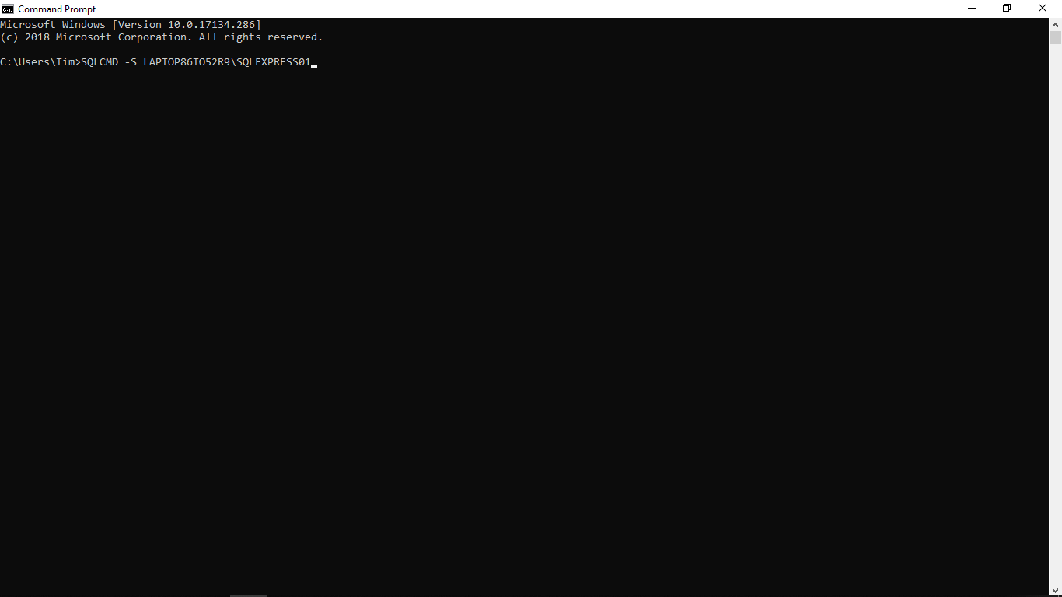
Building Tables with SQLCMD
The slightest typo will kill you

Slide 9
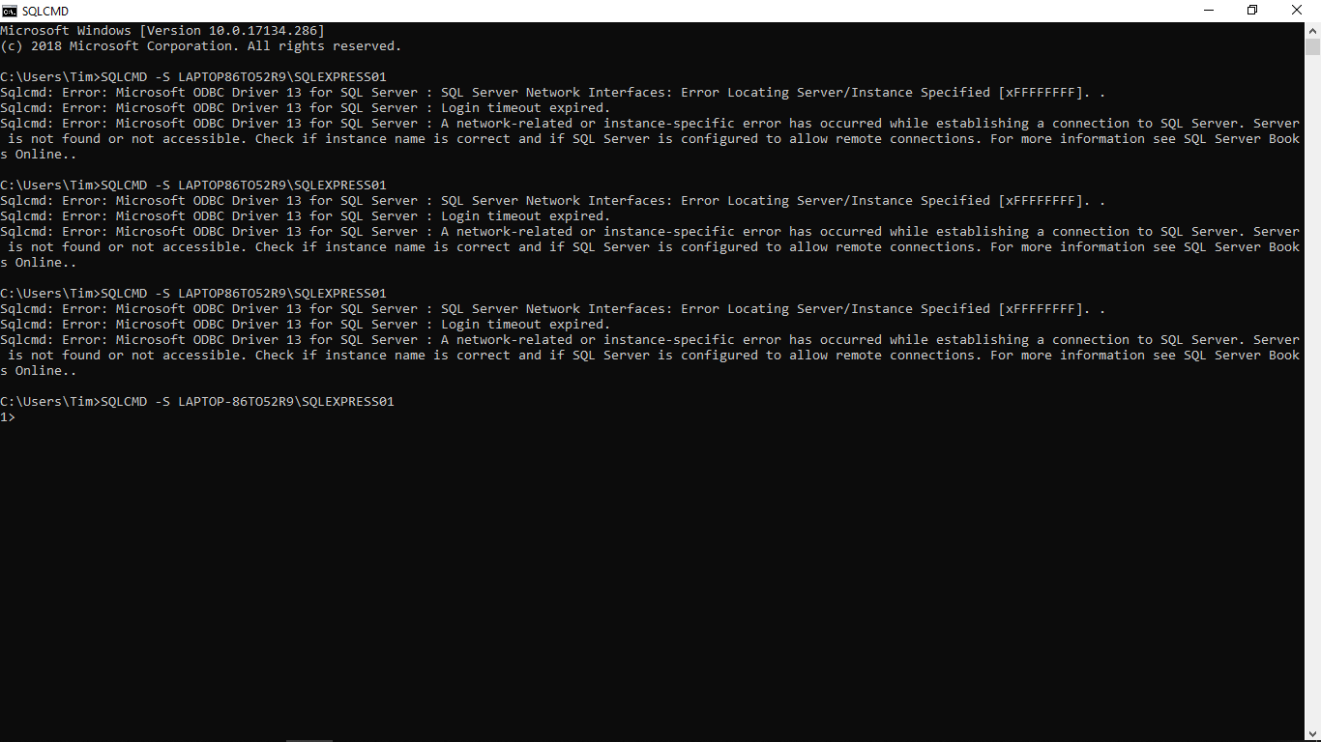
Building Tables with SQLCMD

Slide 10
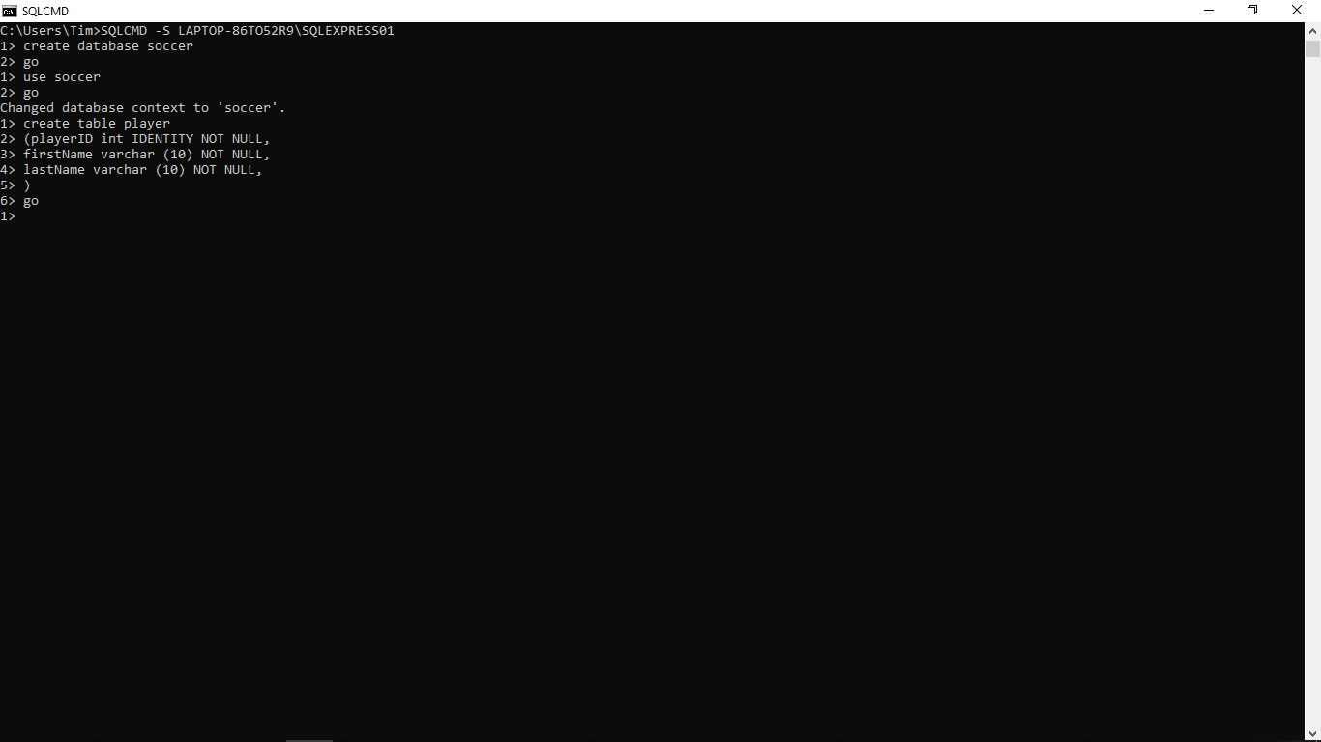
Building Tables with SQLCMD

Slide 11
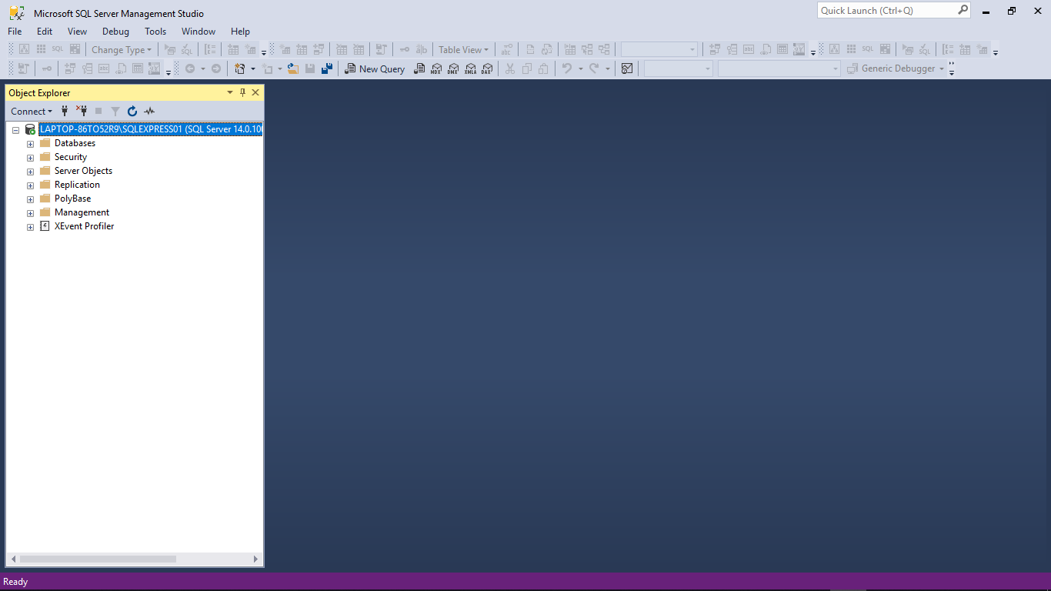
Let’s see if its there…

Slide 12
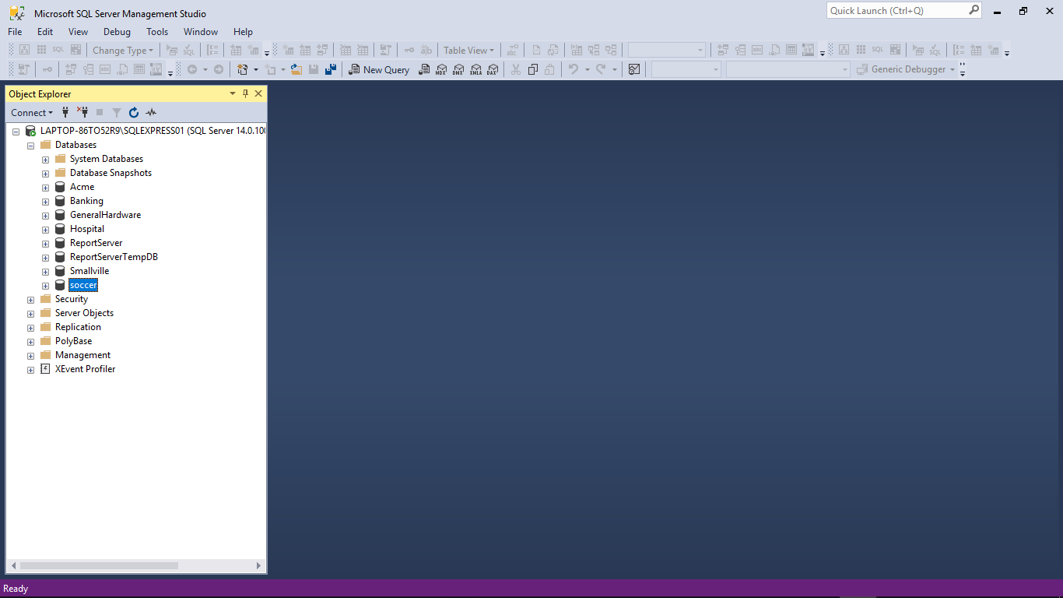
Let’s see if its there…

Slide 13
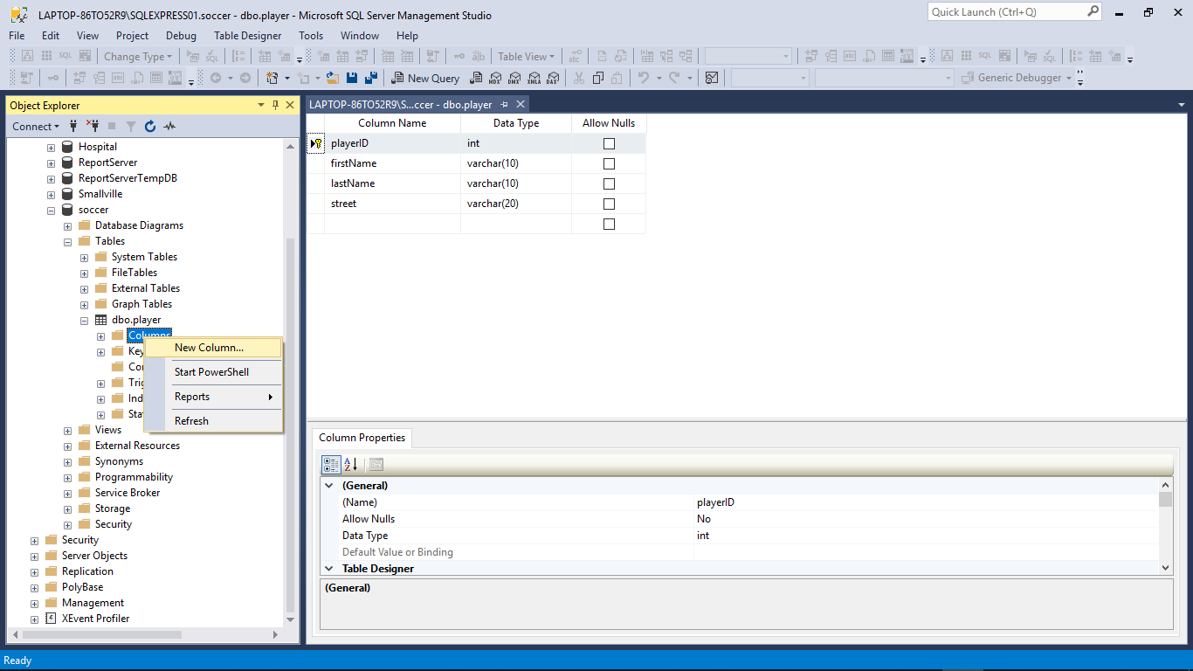

Slide 14
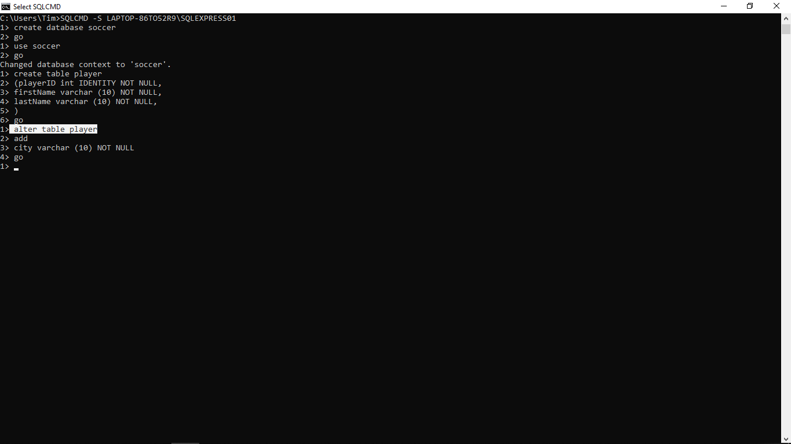

Slide 15
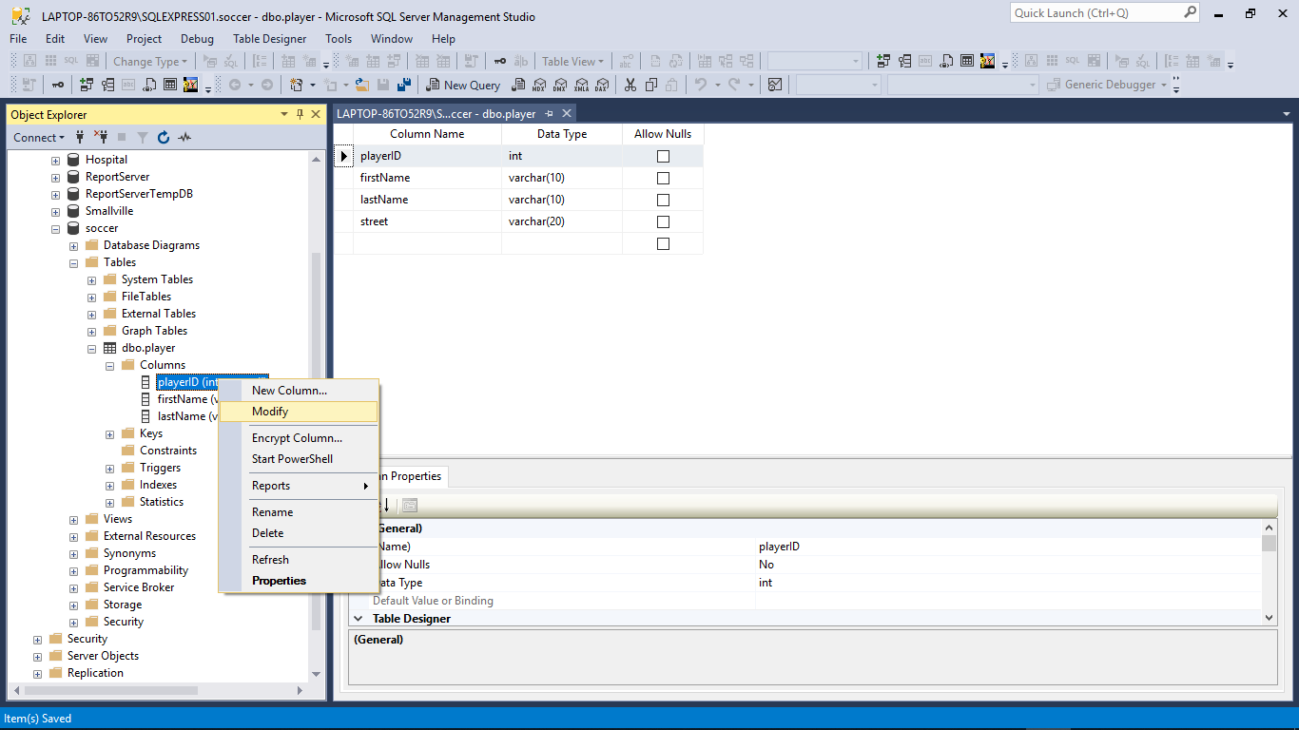

Slide 16
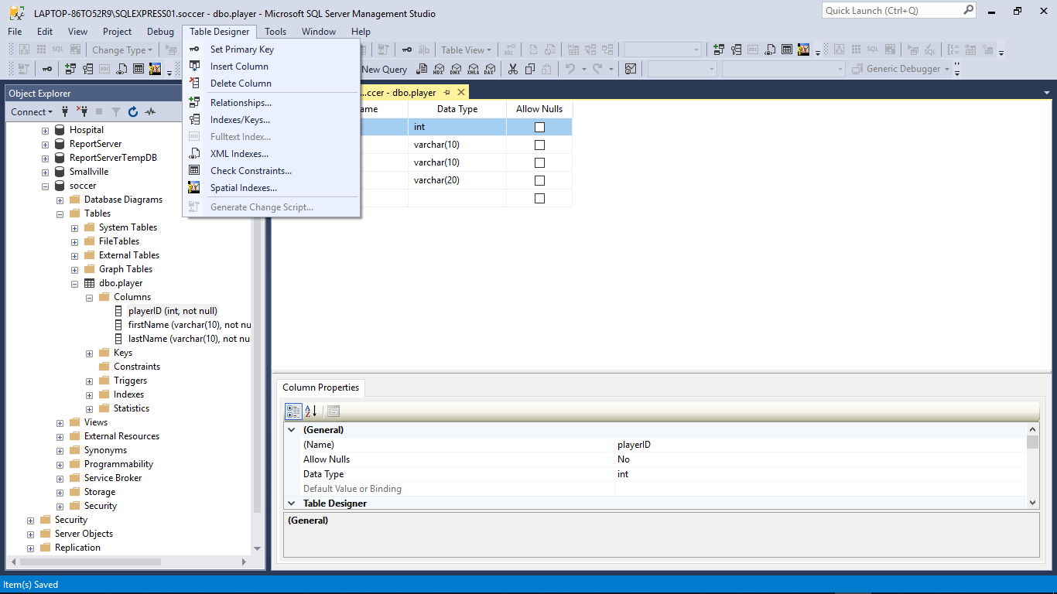

Slide 17
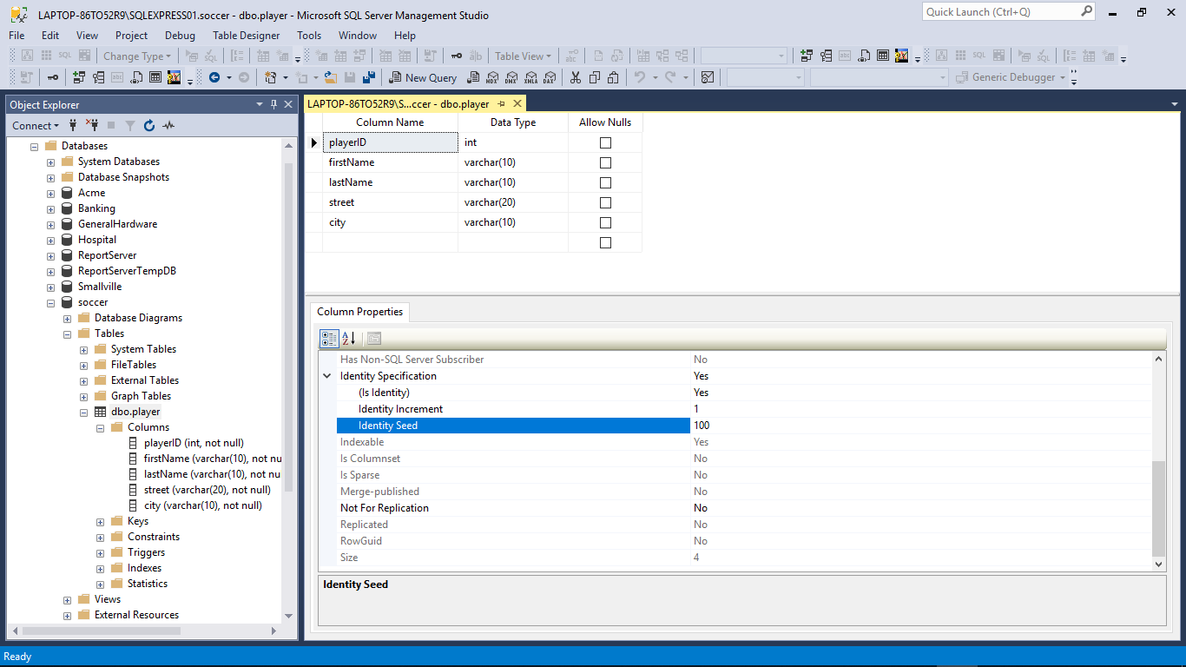

Slide 18
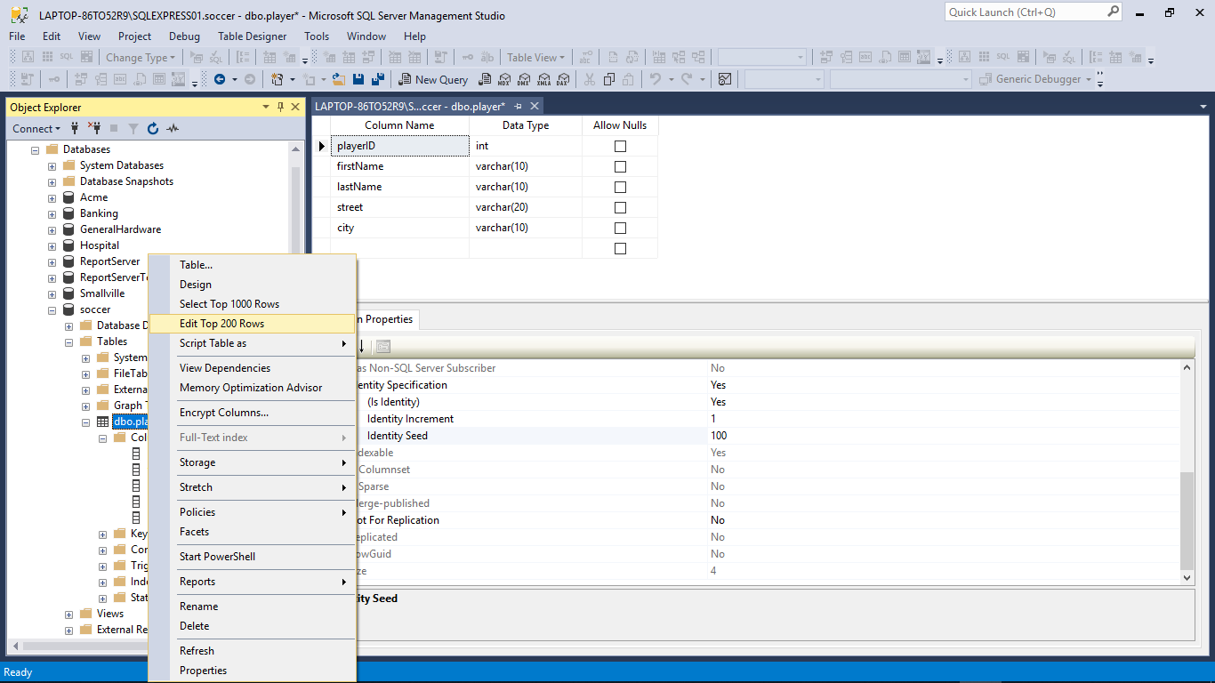

Slide 19
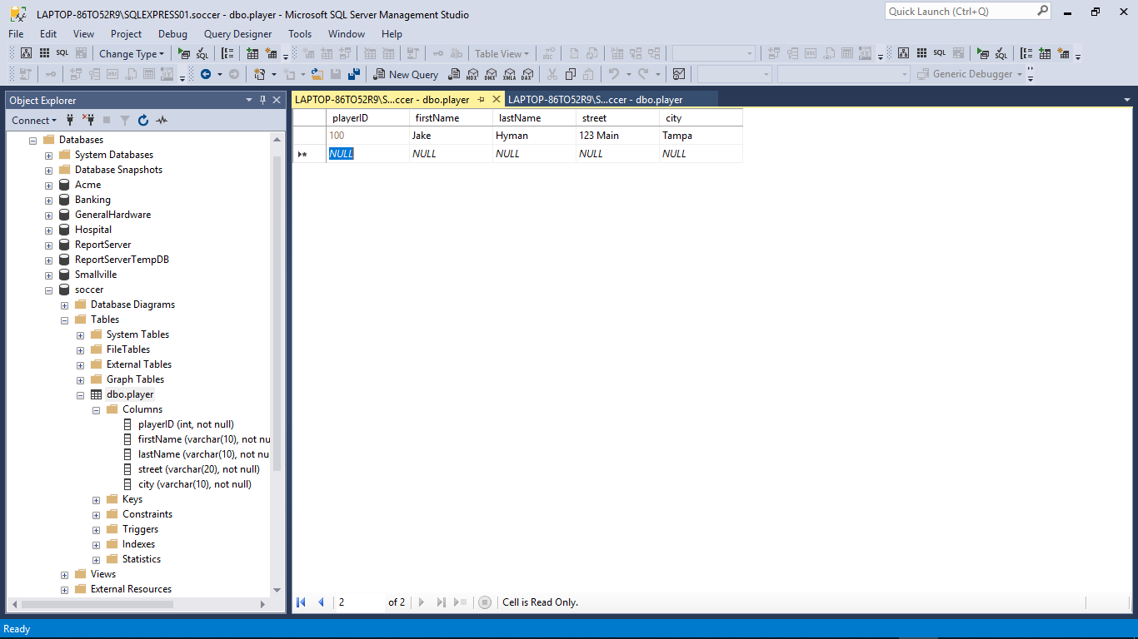

Slide 20
Entering Data and Simple Queries
Entering Data/records
SSMS (edit rows)
SQLCMD (Insert statement)
Queries
New Query (SSMS)
Select statement (select, from, where)
SQLCMD

Slide 21
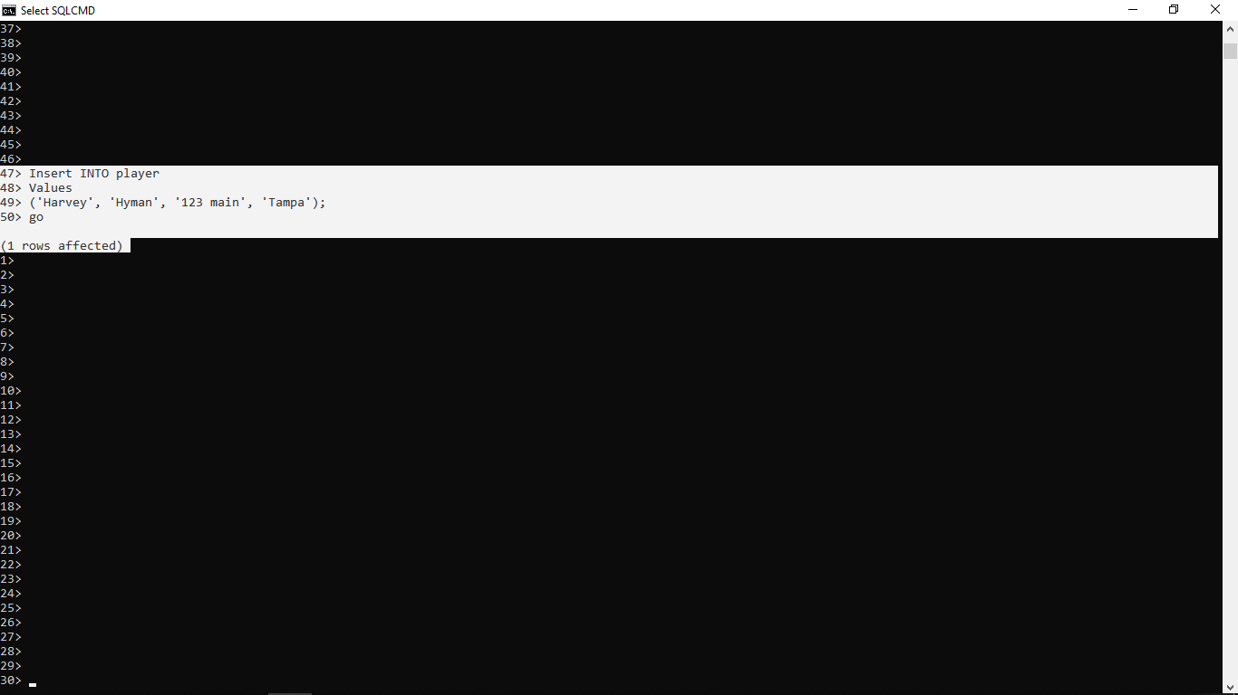

Slide 22
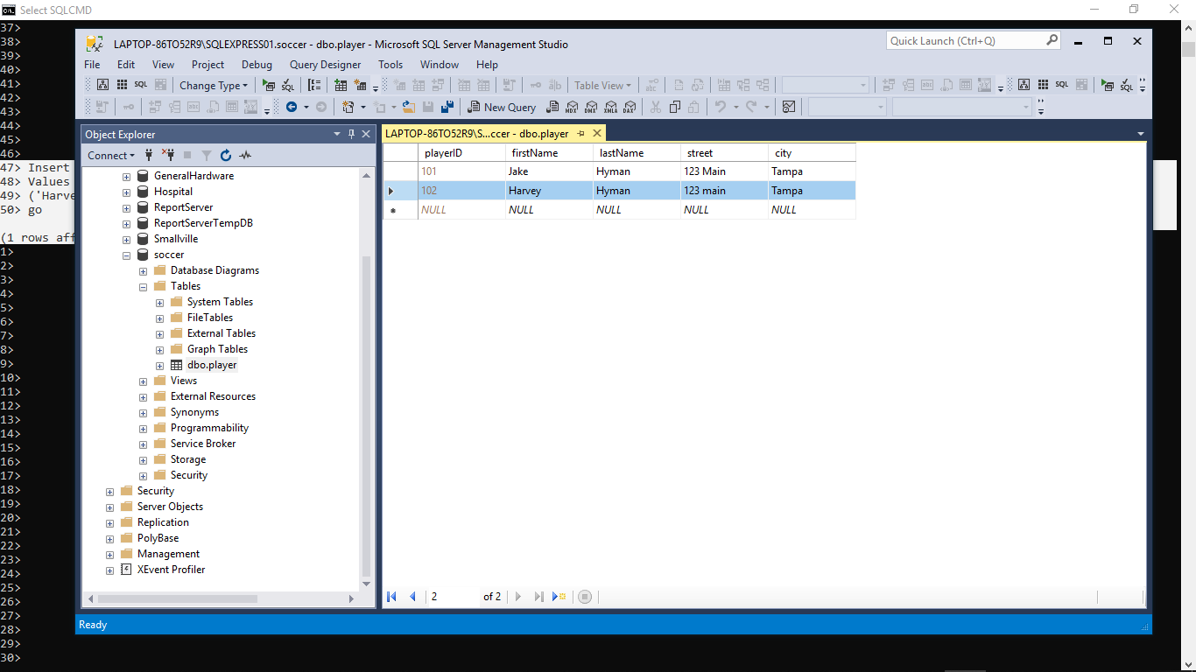

Slide 25
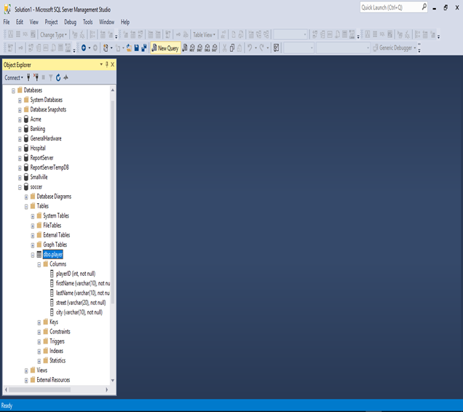

Slide 26
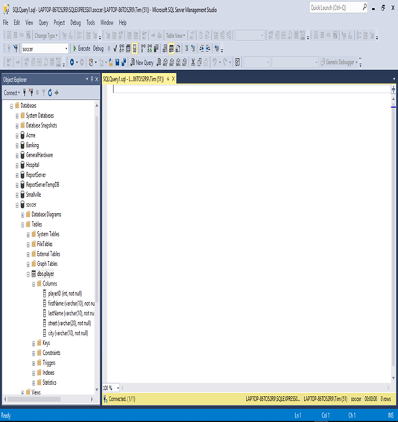

Slide 27
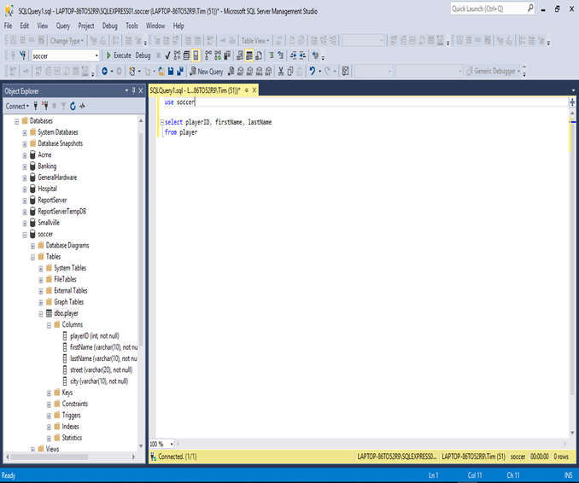
use soccer
select playerID, firstName, lastName
from player

Slide 28
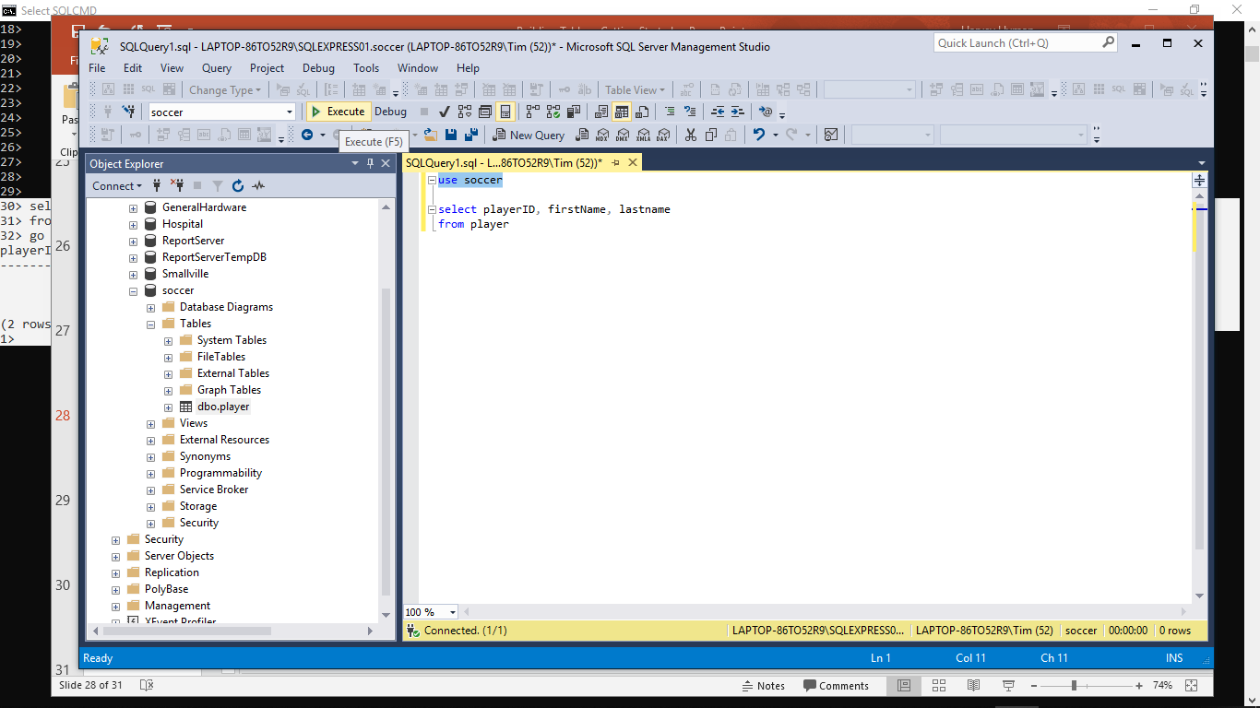

Slide 29
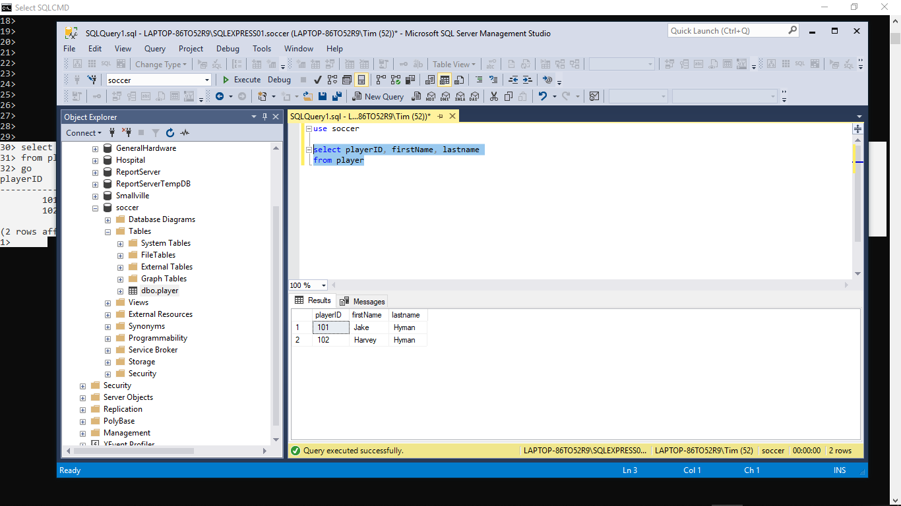

Slide 30
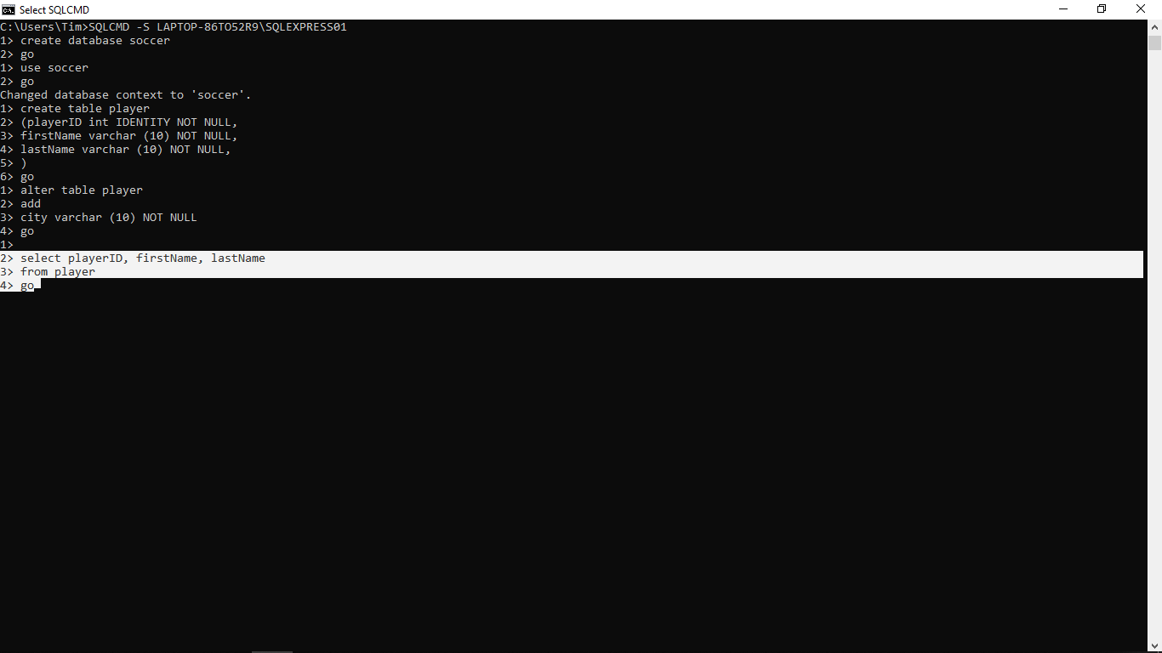

Slide 31
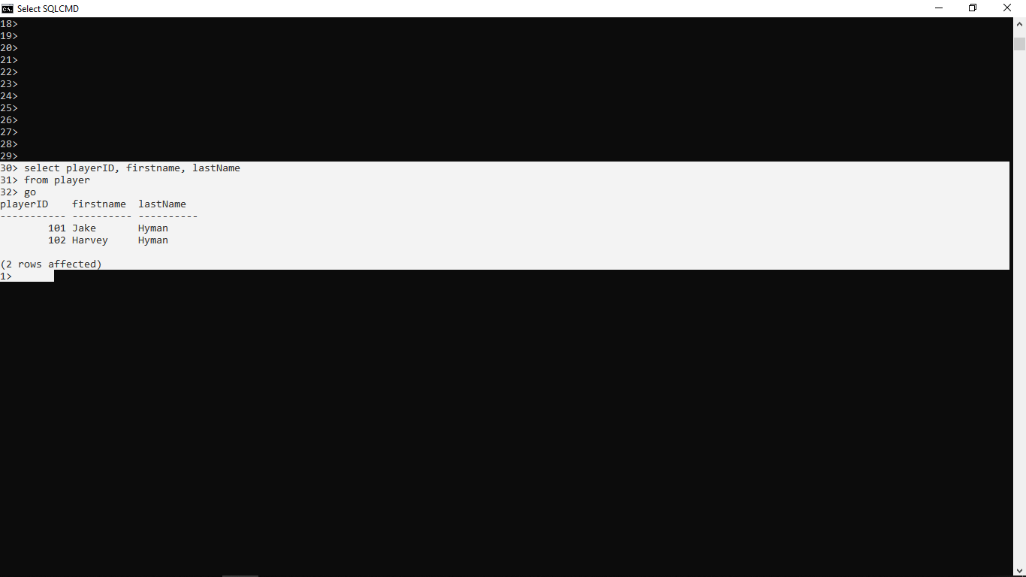

Slide 32
You have everything you need to get started now: - Practice Building Tables with: Hospital and ACME

